Slide 1
Securing REST services
Soham Sengupta

Slide 2
Open APIs- a threat
Different Approaches –
Default Spring Security (HTTP Basic)
Basic HTTP Authentication -
What’s that?
JWT
OAuth 2.0
Many others

Slide 3
What is HTTP Basic Security ?
String x= <myusername>:<mypassword>
String y = Base64Encode (x)
Basic dXNlcjoxNWQwY2NmOC03YTAxLTRiNjQtOWQyZi0xZDdlNDRjZTA1OGE=
user:15d0ccf8-7a01-4b64-9d2f-1d7e44ce058a
After BASE64 Encoding→ dXNlcjoxNWQwY2NmOC03YTAxLTRiNjQtOWQyZi0xZDdlNDRjZTA1OGE=
Basic dXNlcjoxNWQwY2NmOC03YTAxLTRiNjQtOWQyZi0xZDdlNDRjZTA1OGE=
This passes in the Header Authorization of the HTTP Request

Slide 4
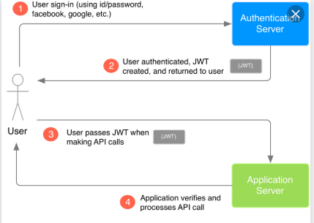
JWT-what and why?
JSON Web Token

Slide 5
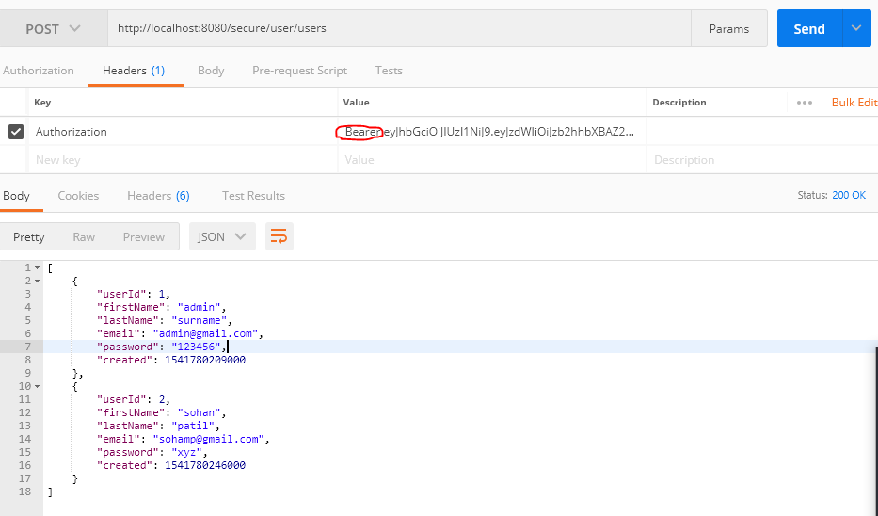
Example

Slide 6


